Slide 1
Scripting Language Part-2

Slide 2
We are going to cover..
1. Introduction to jQuery
2. Basics of jQuery
3. Selectors in jQuery
4. jQuery – DOM Attributes
5. jQuery – DOM Traversing
6. Basic Asp.Net Ajax Controls- AJAX extension controls
7. DOM manipulation with Jquery and Ajax

Slide 3
jQuery Intro..
jQuery is a fast lightweight scripting which is run on client side.
It is the JavaScript library created by John Resig in 2006.
jQuery used with HTML document for traversing.

Slide 4
jQuery support cross-platform.
jQuery follows the "write less do more“ based concepts.
jQuery use for event handling, animation ,DOM manipulation , Ajax calling for Web Development.

Slide 5
jQuery Features
Following core features supported by jQuery
DOM manipulation Support −
Event handling Support −
Cross Browser Support −
AJAX Calling Support −
Lightweight Support −
Animations Support -

Slide 6
How we can use jQuery
There are two ways to use jQuery.
By Using Local Installation − You can download jQuery library on your local machine and include it in your HTML code.

Slide 8
By local installation
Local Installation − You can download jQuery library on your local machine and include it in your HTML code.
Click on https://jquery.com/download/ to download the latest version available.
Now put downloaded jquery-2.1.3.min.js file in a directory of your website, e.g. /jquery.

Slide 9
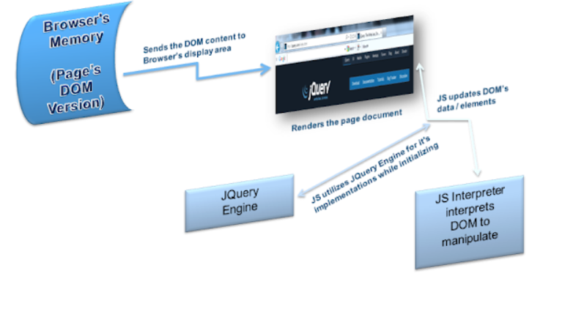

Slide 10
So when Javascript Interpreter starts interprets DOM to manipulate then JQuery Engine come into picture.Javascript utilizes JQuery Engine for it's implementations.
Jquery Engine is nothing but the code written in Javascript.

Slide 11
So when Javascript Interpreter see's the <Script> tag it start interpreting the code line by line.
when any jQuery function like($,.css,.replace etc...) comes in between then Javascript Interpreter look's for implementation of those jQuery function in jQuery Engine and this way it will execute the code.

Slide 12
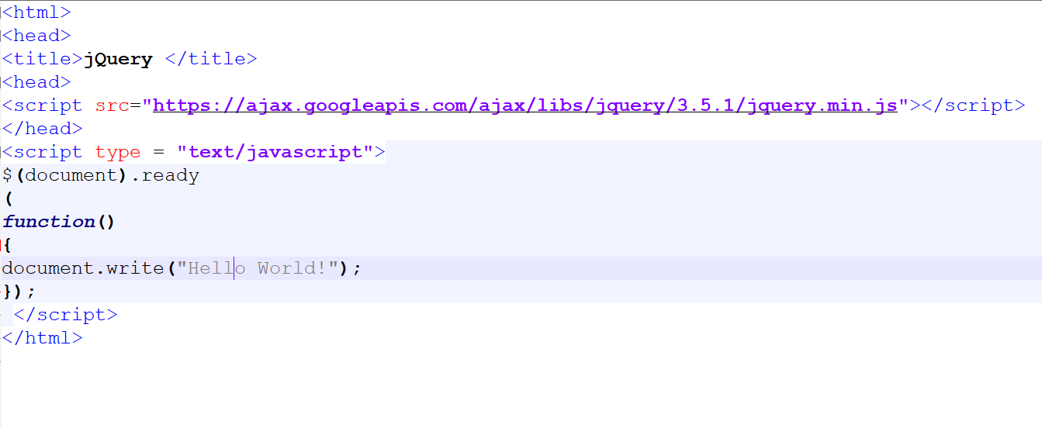
jQuery Hello World

Slide 13
Call jQuery Library Functions
Everything inside it will load as soon as the DOM is loaded and before the page contents are loaded.
$(document).ready(
function() {
// do stuff when DOM is ready
});

Slide 14
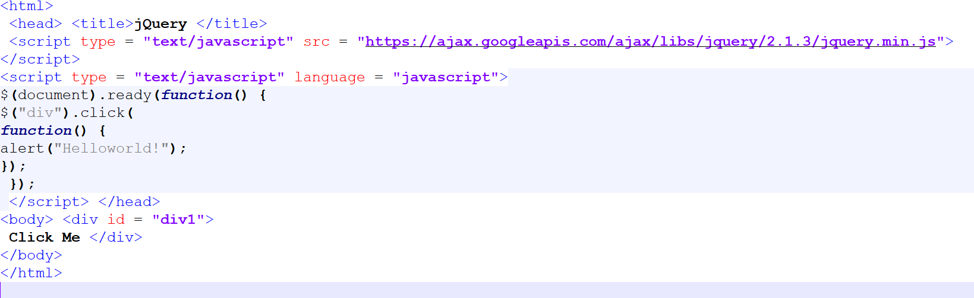

Slide 15
jQuery Functions
A function in JavaScript can be named or anonymous.
A named function we use function keyword as follows −
function my1()
{
// do some
}

Slide 16
An anonymous function can be defined in similar way like that
var fun = function ()
{
// code here
}
anonymous functions in jQuery

Slide 17
$(document).ready(function()
{
// do some stuff here
});

Slide 18
jQuery In Built Functions
JavaScript has support more built-in functions which are the which are the following ..
1.charAt()
Returns the character at the specified index.
2.concat()
Combines the text of two strings and returns a new string.
3.forEach()
Calls a function for each element in the array.

Slide 19
4.indexOf()
Returns the index within the calling String object of the first occurrence of the specified value, or -1 if not found.
5.length()
Returns the length of the string.
6.pop()
Removes the last element from an array and returns that element.
7.push()
Adds one or more elements to the end of an array and returns the new length of the array.
8.reverse()
Reverses the order of the elements of an array -- the first becomes the last, and the last becomes the first.

Slide 20
9.sort()
Sorts the elements of an array.
10.substr()
Returns the characters in a string beginning at the specified location through the specified number of characters.
11.toLowerCase()
Returns the calling string value converted to lower case.
12.toString()
Returns the string representation of the number's value.
13.toUpperCase()
Returns the calling string value converted to uppercase.

Slide 21
DOM
DOM is a collection of tree elements in the HTML .
The <p> elements are children (and descendants) of <div>, descendants of <body> and <html>, and siblings of each other <p> elements.

Slide 22
jQuery Selectors
Using jQuery selectors we can used to select one or more HTML elements .
After selecting we can perform various operations on that selected element.
jQuery selectors start with the dollar sign and parentheses −
e.g. $(). This is the factory function.

Slide 23
$() factory function
jQuery selector start with $(). This sign is called factory function. We can use the selectors by three ways..
1.Tag Name:
By using tag name It is available in the DOM. For example: $('p') which is selects all paragraphs in the document.
2.Tag ID:
Iby using tag ID It is available in the DOM. For example: $('#rid') which is selects a specific element in the document using id.

Slide 24
3.Tag Class:
It represents a tag available with a specific class in the DOM. For example: $('.classname') selects all elements in the document that have class.

Slide 25
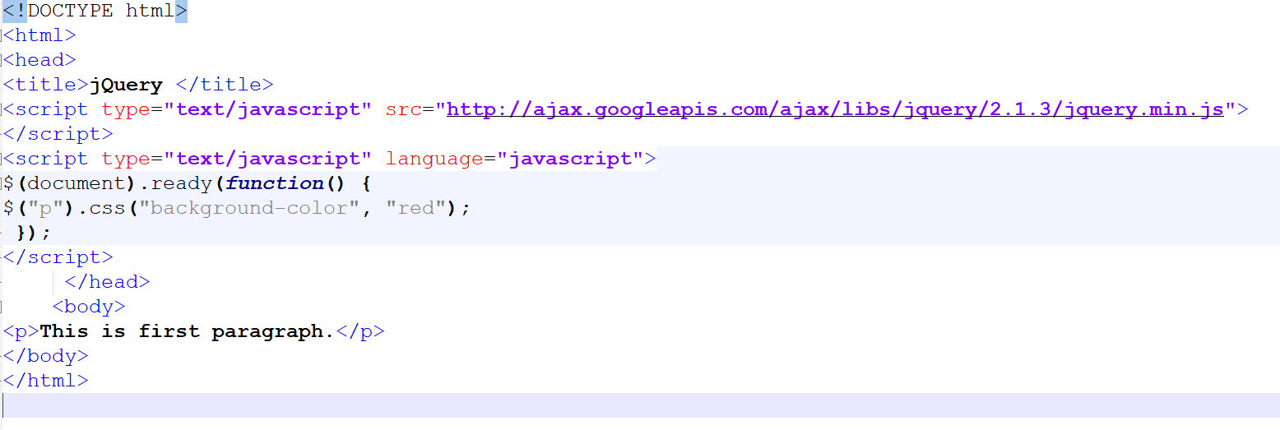

Slide 26
More jQuery Selectors
1.*:-$("*")-It is used to select all elements.
2.#id:-$("#firstname")-It will select the element with id="firstname"
3..class:-$(".primary")-It will select all elements with class="primary"
4.element $("p") It will select all p elements.
5.el1,el2,el3 :- $("h1,div,p") It will select all h1, div, and p elements.

Slide 27
jQuery Effects
Using jQuery effects we can add effects on a web page.
there are lot of jQuery effects can be categorized like fading, sliding, hiding , showing etc.

Slide 28
1.Fading Effects:-fadeIn(),fadeOut(),fadeToggle(),fadeTo().
2.Sliding Effects:-slideUp(),SlideDown(),SlideToggle().
3.Display Effects:-hide(),show(),toggle().

Slide 29
jQuery Hide()
Using this method we can hide the element .
Syntax:
$(selector).hide();
$(selector).hide(speed, callback);
$(selector).hide(speed, easing, callback);

Slide 30
speed: It is optional parameter. which is used the speed of the delay.
easing: This function to be used for transition.
callback: It is used to calling the function to be called after completion of the task

Slide 31
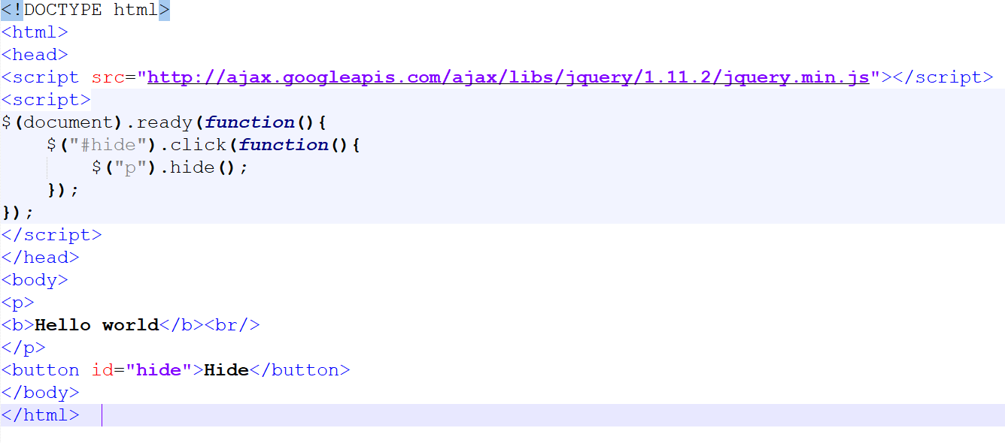

Slide 32
show()
Using this method we can show the element .
Syntax:
$(selector).show();
$(selector).show(speed, callback);
$(selector).show(speed, easing, callback);

Slide 33
<script>
$(document).ready(function(){
$("#hide").click(function(){
$("p").hide();
});
$("#show").click(function(){
$("p").show();
});
});
</script>

Slide 34
toggle()
It is use for shows the hidden elements and hides the shown element.
Syntax:
$(selector).toggle();
$(selector).toggle(speed, callback);
$(selector).toggle(speed, easing, callback);
$(selector).toggle(display);

Slide 35
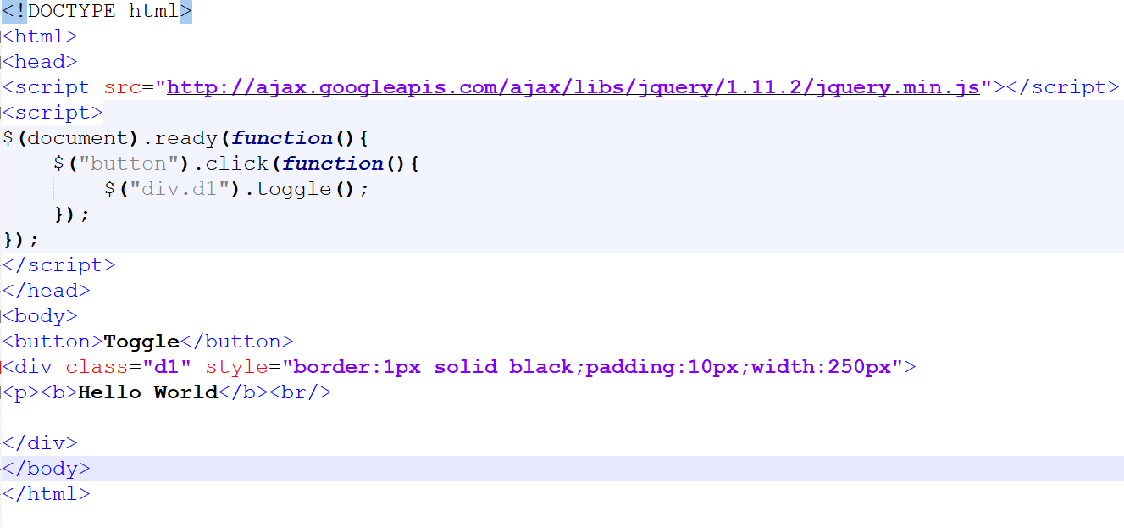

Slide 37
Fade In()
This method is used to put the fade in the element.
Syntax:
$(selector).fadein();
$(selector).fadeIn(speed,callback);
$(selector).fadeIn(speed, easing, callback);

Slide 38
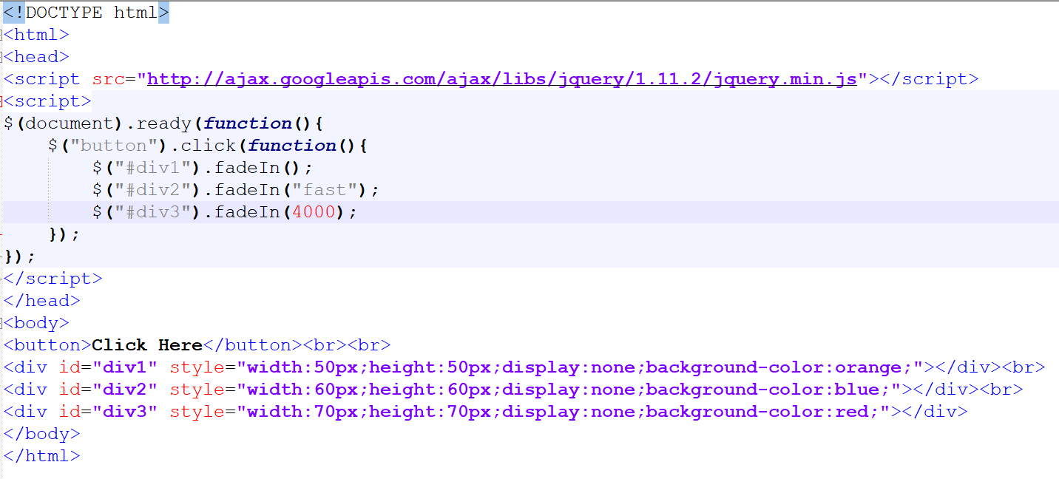

Slide 39
Fade out()
It is perform the fade Out operations
Syntax:
$(selector).fadeOut();
$(selector).fadeOut(speed,callback);
$(selector).fadeOut(speed, easing, callback);

Slide 40
<script>
$(document).ready(function(){
$("button").click(function(){
$("#div1").fadeOut();
$("#div2").fadeOut("slow");
$("#div3").fadeOut(2000);
});
});

Slide 41
Fade toggle()
It is the combination of between the fadeIn() and fadeOut() methods.
When faded in perform then , it will make them faded out and if they are faded out it will make them faded in.
Syntax:
$(selector).fadeToggle();
$(selector).fadeToggle(speed,callback);
$(selector).fadeToggle(speed, easing, callback);

Slide 42
$(document).ready(function(){
$("button").click(function(){
$("#div1").fadeToggle();
$("#div2").fadeToggle("slow");
$("#div3").fadeToggle(5000);
});
});

Slide 43
fadeTo()
$(selector).fadeTo(speed, opacity);
$(selector).fadeTo(speed, opacity, callback);
$(selector).fadeTo(speed, opacity, easing, callback);

Slide 44
$(document).ready(function(){
$("button").click(function(){
$("#div1").fadeTo("slow", 0.2);
$("#div2").fadeTo("slow", 0.1);
});
});

Slide 45
Slide down()
Syntax:
$(selector).slideDown(speed);
$(selector).slideDown(speed, callback);
$(selector).slideDown(speed, easing, callback);

Slide 46
$(document).ready(function(){
$("#flip").click(function(){
$("#p").slideDown("fast"); });
});
</script>
<style>
#p1, #p2 {
padding: 10px;
text-align: right;
background-color: green;
border: solid 1px #blue;
}
#p1{
padding: 80px;
display: none;
}

Slide 47
jQuery Animate()
Used to perform animation using html tags.
Syntax:
$(selector).animate({params}, speed, callback);

Slide 48
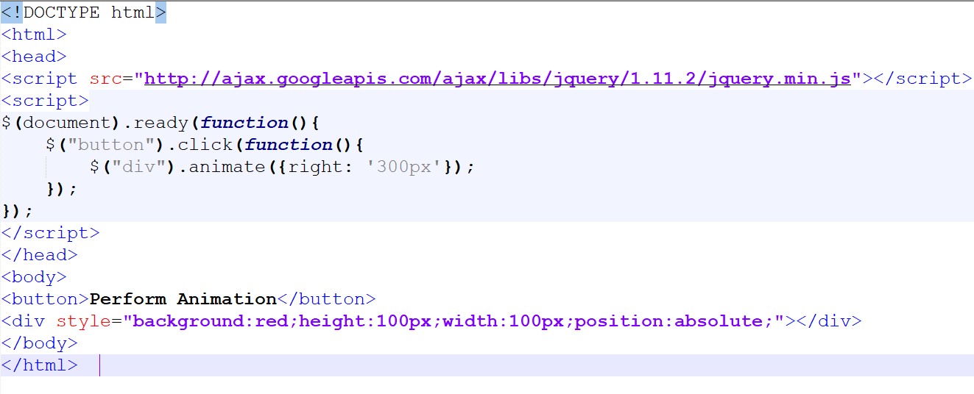

Slide 49
Animate with properties
$(document).ready(function(){
$("button").click(function(){
$("div").animate({
left: '150px',
opacity: '0.3',
height: '150px',
});
});
});

Slide 50
<script>
$(document).ready(function(){
$("button").click(function(){
$("div").animate({
left: '250px',
height: '+=350px',
width: '+=450px'
});
});
});

Slide 51
jQuery Events
We can perform events with jQuery.
Syntax:
$(document).ready(function(){
$("p").click(function(){
document.write("You Clicked on Parigraph");
});
});

Slide 52
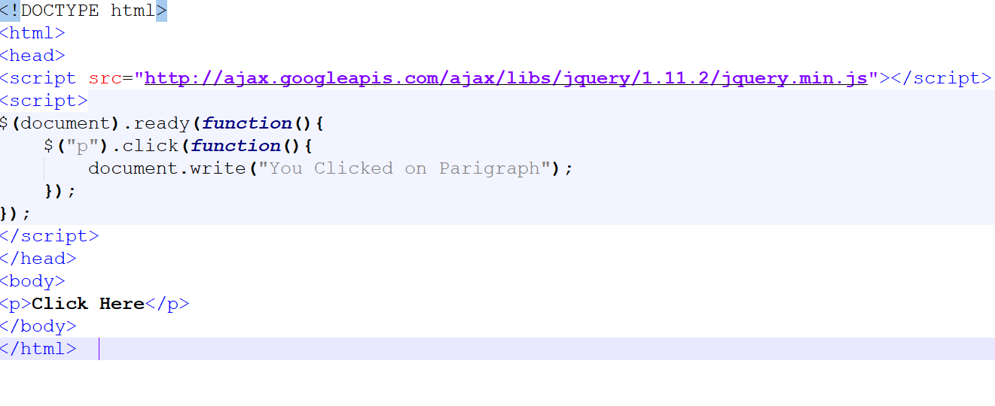

Slide 53
Basic Form Validation With jQuery
Want to perform some validation in form they follow this steps.
1.Add these cdn jquery files in scripting of the page section.
<script src="https://cdnjs.cloudflare.com/ajax/libs/jquery/3.4.0/jquery.min.js"></script>
<script src="https://cdnjs.cloudflare.com/ajax/libs/jquery-validate/1.19.0/jquery.validate.min.js"></script>

Slide 54
